Slide 1

Clearing the Air
Understanding the factors behind the number of bookings an AirBnB receives
Coursera Data Science Capstone

Slide 2
Introduction
AirBnB have become a staple in the ‘sharing economy’
Controlling the details of an AirBnB listing provides freedom and flexibility and can influence how many bookings are brought in
Popularity of AirBnB has led to increasing real estate prices and increased competition from other AirBnBs, making it a riskier enterprise
Every advantage should be taken to ensure success of an AirBnB
Understanding what factors influence an AirBnB success would be hugely advantageous for both newcomers and experienced AirBnB hosts

Slide 3
Data
Data taken from dataset of AirBnB listings in New York City throughout 2019
Data was compiled by Kaggle user Dgomovon
Data was pulled directly from AirBnB website using openly available listings
Data consisted of name of the listing, listing ID, host name, host ID, borough it was located in, specific neighbourhood it was located in, address of listing, latitude and longitude, room type, price per night, minimum nights required to stay, number of reviews the listing had received and other miscellaneous details.
How many bookings a listings receives is not publicly available so number of reviews was used as a proxy
FourSquare API was used to pull museums in New York City
It was hypothesized that distance to amenities such as museums could influence the number of bookings received

Slide 4
Methodology
Analysis was done in Python 3 using libraries such as Numpy, Pandas, SciKit Learn, Geopy, Folium and more
Dataset was pulled in as csv and loaded onto dataframe
Data was explored using descriptive statistics, various boxplots and scatterplots examining distributions and relationships between variables
Geographical data of AirBnB listings was used to construct a visualization map
FourSquare API was used with a search query of ‘museum’ to pull museums in New York City
FourSquare data was also appended to the map, providing a visualization of museums and AirBnBs in New York

Slide 5
Methodology cont.
Data cleaning saw listings with a price of 0, prices above $500 per night and minimum stays longer than 31 nights to remove outliers and improve distribution
Given the three most popular museums in NYC (Natural History Museum, MOMA and Guggenheim) were in Central Park, it was determined that distance from Central Park should be considered as a factor for an AirBnB listing
The distance from Central Park for each AirBnB was calculated
Boxplots and scatterplots were used to examine relationships between the distance from Central Park and other factors such as price and number of reviews
Scatterplots were also built to examine relationships between price, minimum nights and number of reviews

Slide 6
Methodology cont.
A linear regression model was built examining the relationship between the number of reviews for a listing and it’s distance from Central Park
Data was split, trained and tested with a testing split of 20%
Metrics of Mean Absolute Error (MAE), Mean Squared Error (MSE), and Root Mean Squared Error (RMSE) used for evaluation
A polynomial regression model was also built for the same relationship to assess if it could be polynomial in nature

Slide 7
Methodology cont.
A multiple linear regression model was built examining the relationship between number of reviews, price of a listing and minimum nights for a stay
Data was split, trained and tested with a 20% testing split
Iterative polynomial model was also applied to the same relationship
FourSquare API used to find all museums in a 2km radius of SoHo where most museums were clustered. AirBnBs were limited to only those in Manhattan.
Distance of AirBnBs in Manhattan from the average museum in SoHo was calculated

Slide 8
Methodology cont.
A linear regression model was run between distance from the average museum and the number of reviews for a listing
Data split, trained and tested with 20% testing split
Evaluated using metrics of MAE, MSE, RMSE

Slide 9
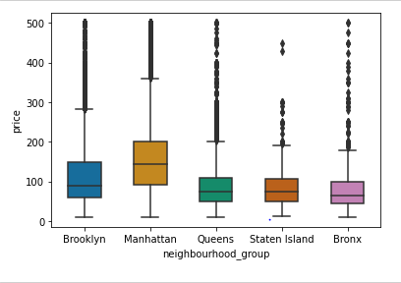
Results
There were 48,895 AirBnB listings in the initial dataset. The largest minimum number of nights required to stay was 1250 nights and the maximum price per night was $10,000. The average AirBnB received 23 reviews, required a minimum 7 nights stay and cost $150 per night.
Manhattan had the highest average price per night, followed closely by Brooklyn. The Bronx had the lowest average price per night, being the cheapest place to find an AirBnB.
Conversely, Staten Island received the highest number of reviews while Manhattan had the least.

Slide 10
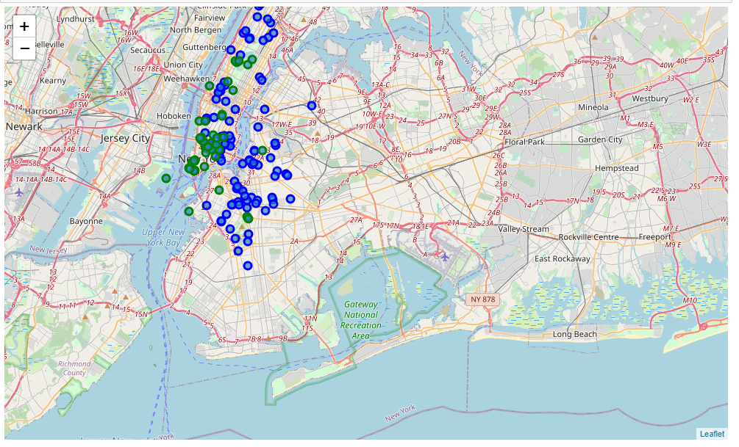
Results cont.
AirBnBs and museums pulled from FourSquare data were visualized on a map of New York, with AirBnBs represented by blue markers and museums represented by green markers
Museums were highly clustered in the south of Manhattan while AirBnBs were distributed out

Slide 11
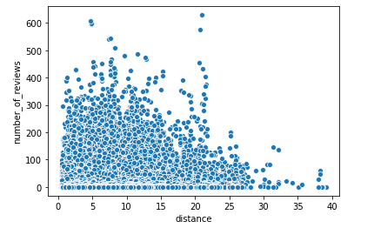
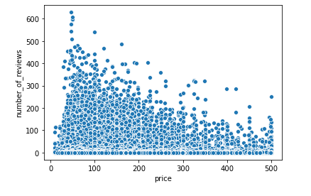
Results cont.
There appeared to be a relationship between the number of reviews a listing received and its distance from Central Park. As the distance increased, the number of reviews decreased with this effect pronounced after the 20km mark.
There was a downward trend in the relationship between the price of a listing and the number of reviews a listing had. As the price increased, the number of reviews decreased with the highest number of reviews seen at the $50 mark.

Slide 12
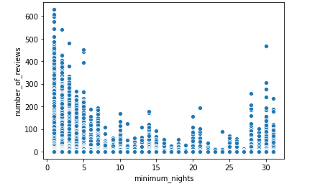
Results cont.
There was a parabolic relationship between the number of reviews a listing had and the number of minimum nights required. Reviews was highest for the 1 night mark before slowly decreasing to a low at the 15 night mark and then increasing up at the 30 night mark. This implies that while short stays are preferable, month long stays are also a viable option.

Slide 13
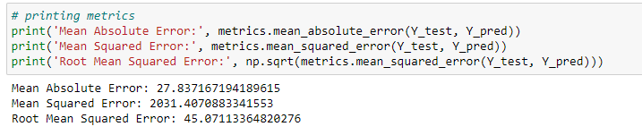
Results cont.
The linear regression model between the distance from Central Park and the number of reviews a listing had showed an intercept of 20.17 and co-efficient of 0.49. This implies that as the distance from Central Park increased, the number of reviews increased as well.
However the MAE, MSE and RSME found shows that this model was inaccurate and should be approached with caution.

Slide 14
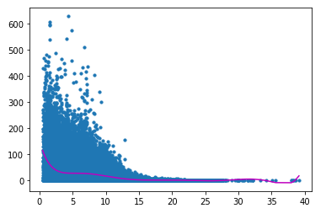
Results cont.
The polynomial model was evaluated to be inaccurate. The metrics found an r2 and RMSE of 0.12 and 41.92 respectively, showing that a polynomial relationship between number of reviews and distance from Central Park was both weak and inaccurate.
In addition, the model was prone to both underfitting and overfitting at the tail end as shown by the scatterplot visualization and line of best fit.
Thus it is unlikely that the relationship is polynomial in nature.

Slide 15
Results cont.
The multiple regression model between price of a listing, minimum nights required and the number of reviews received showed that price had a minute negative effect with a coefficient of -0.02 and minimum nights had a negative effect of -0.77.
This implied that while increases in both price and minimum nights required for a stay led to decreases in number of reviews, the effect of minimum nights is much stronger and thus more attention should be paid to setting the minimum nights when seeking bookings
This model was evaluated to be inaccurate with a MAE and RMSE of 27.26 and 44.54.
A polynomial relationship was conducted and evaluated as not applicable to this relationship based on the metrics found of 44.16 and 0.03 for RMSE and r2 respectively.

Slide 16
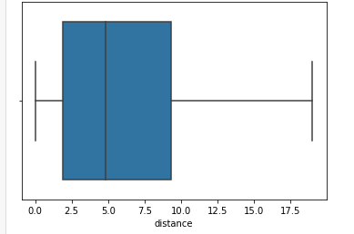
Results cont.
The distribution of distances from the average museum found that 50% of AirBnBs in Manhattan were 2.5 – 9.5 kms away from the average museum. This is a large spread showing AirBnBs are widely distributed around Manhattan.
The linear regression model examining the relationship between number of reviews and the distance from the average museum in SoHo showed a co-efficient of 0.42 indicating a positive relationship that as the distance increases, the number of reviews increased. This is an inaccurate model as shown by the metrics of 25.95 and 42.60 for the MAE and RMSE respectively.

Slide 17
Discussion
Manhattan was the priciest place to stay but Staten Island received the most average reviews, and ergo the most average bookings
The smaller the minimum nights required for a stay, the more bookings a listing received. This surges again at the 30 night mark where month long stays can be a viable strategy.
Prices around the $50-$100 mark produced the most reviews, however price is not an important factor as minimum nights required for a stay
Distance from Central Park and other amenities did not play a large role in number of reviews produced, showing AirBnB customers were happy to travel around
This analysis is underpinned by the assumption that number of reviews is representative of number of bookings and that reviewing pattern was equal across the different price ranges/boroughs

Slide 18
Recommendations
Staten Island is a good place for an AirBnB.
Keep the nights short to 1-3 nights, or go long for 30 nights
Keep the price low around $50-$100 but remember minimum nights mattered far more than the price range
If setting up in Manhattan, don’t feel pressured to set up near Central Park or other hotspots like SoHo, customers are happy to travel around

